Slide 1
Site Layout. Best practices. Cross browser’s implementation.
Petrivska Marianna

Slide 2
What is a layout? A website layout is a pattern (or framework) that defines a website’s structure. It has the role of structuring the information present on a site both for the website’s owner and for users. It provides clear paths for navigation within webpages. There’s a strong relationship between the layout and the engagement of users with the website. It determines how long they dwell on the website pages, how many pages they browse and how often they come back to the website.
Petrivska Marianna

Slide 3
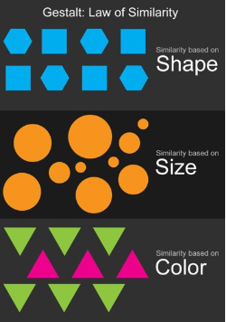

Gestalt law of closure If an image shape is not complete, the human eye tends to fill in the visual gaps and recognize the image as a whole. You won’t pay attention to details, rather focusing on the global view of the pages forming the website; users will find themselves the meaning path

Slide 4
Table layout(based on the HTML tables creation) Table layout has a lot of advantages: it is simple, convenient for adaptation to different browsers, and easily transformed to "rubber" meaning it adapts to different screen widths thanks to the tables auto formatting. But there are also shortcomings: it has a rather large code, which makes each page and site heavier, some design options are complex to implement, and pages load slowly. Block layout(layer layout based on CSS) Such web sites are convenient for search engines indexing, and they always load pages quickly, having a compact code. There are also problems with adapting block layout to different browsers, and for the site to display on screens with different resolutions you need to make separate configurations in css. Fixed layout(static) In this case, if the screen resolution is lower, the user will be able to scroll the page, and if the screen resolution is higher, they will be displayed only at the standard (assigned) page width.
Petrivska Marianna

Slide 5
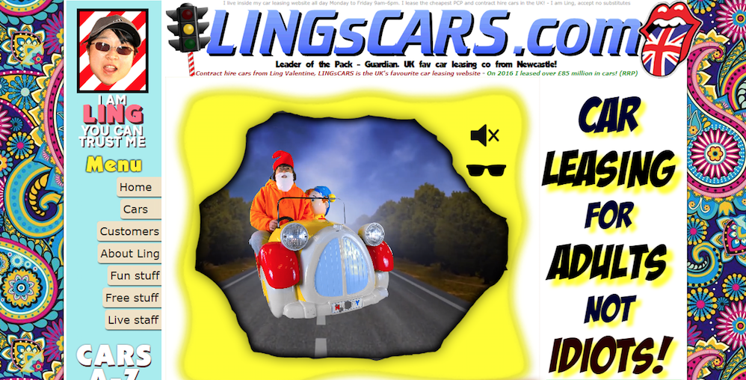
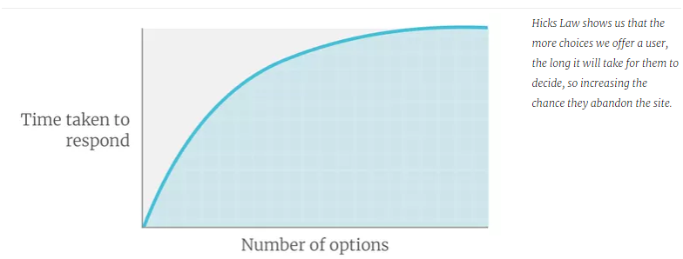
Lifehacks 1)Leave plenty of white space between elements. White space — also called negative space — gives website elements room to “breathe” visually. Bad example:
2)Reduce the number of choices you offer your visitors

Slide 6
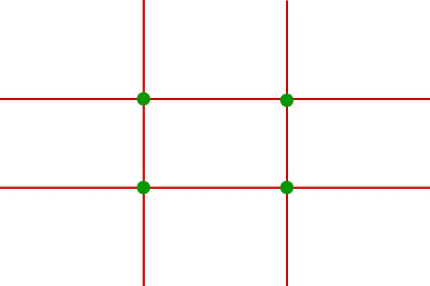
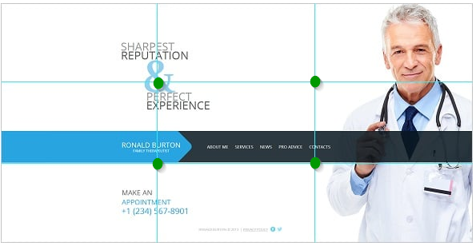
3)Apply the rule of thirds

Slide 7
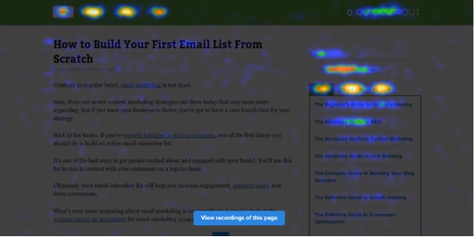

4)Compress images as much as possible According to MachMetrics, a site speed monitoring service, the ideal website load time is just 3 seconds. The easiest way to increase the speed is to compress the images 5) Add breadcrumbs 6)Use contrast to emphasize on CTAs(Call-to-actions) 7)Remove sliders and carousels 8) Create bullets instead of long sentences 9)Scrolling and heat maps. When visitors tend to stop scrolling on the page, plunk down a CTA and make sure all essential information is above that point.

Slide 8
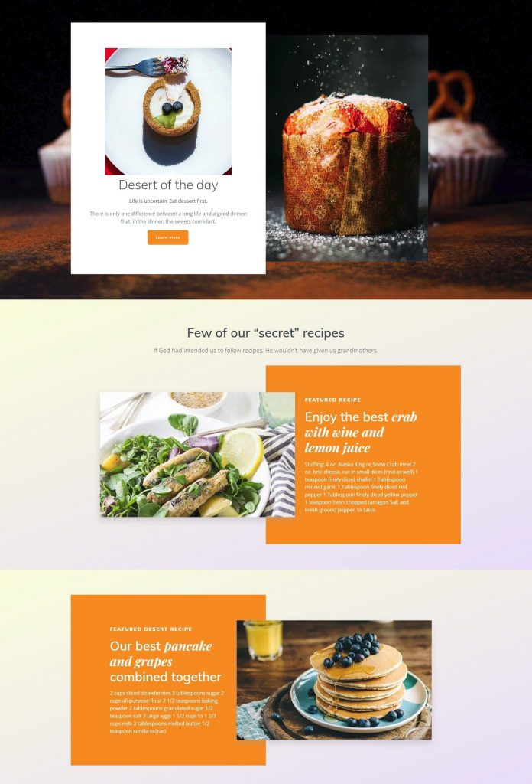
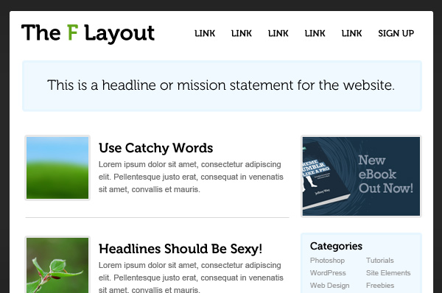
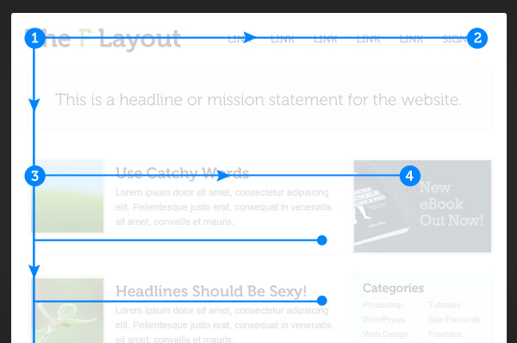
Z-letter and F-layout. When user opens the site, their eyes make a letter Z and F(for business websites and portfolio websites.)

Slide 9

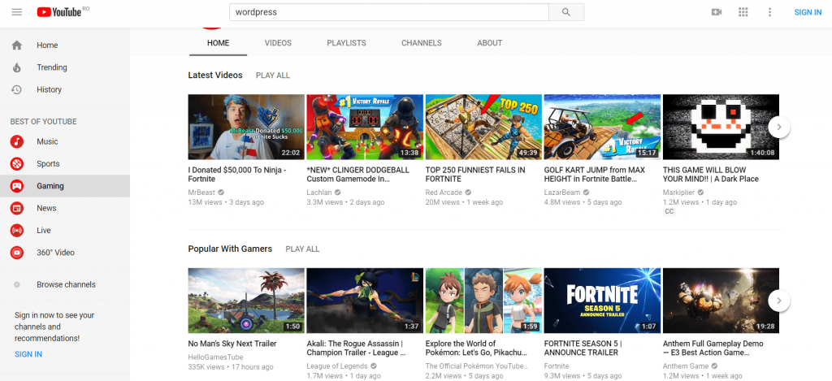
Full Screen Photo and grid layout

Slide 10
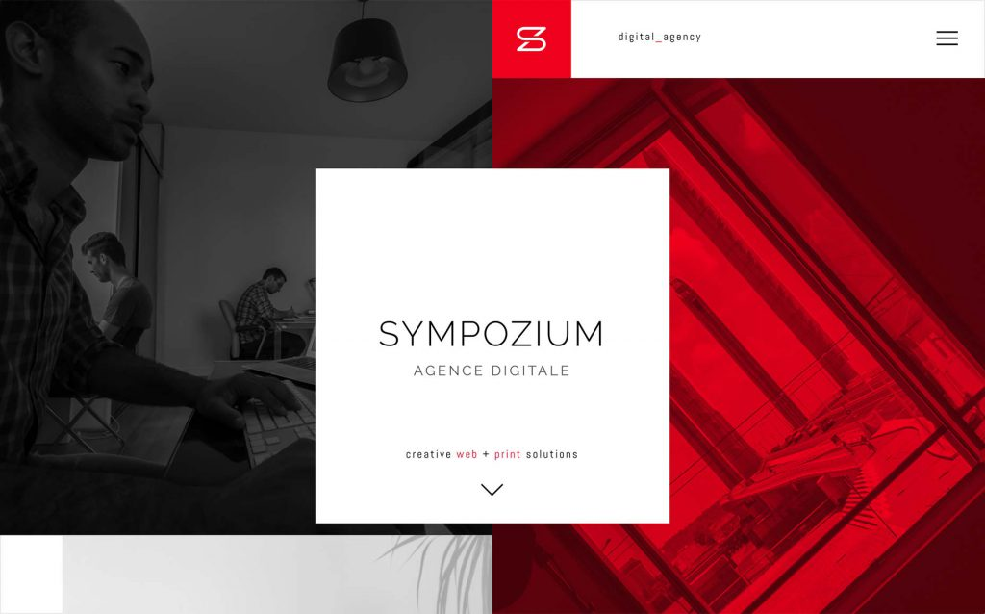
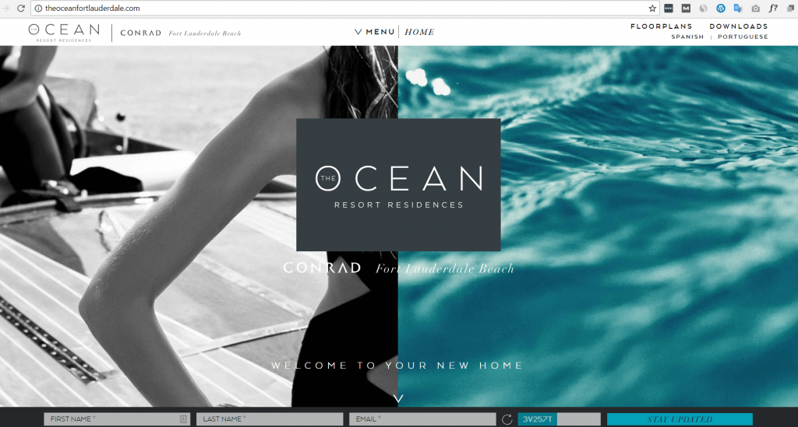
Asymmetrical and split-screen layouts

Slide 11
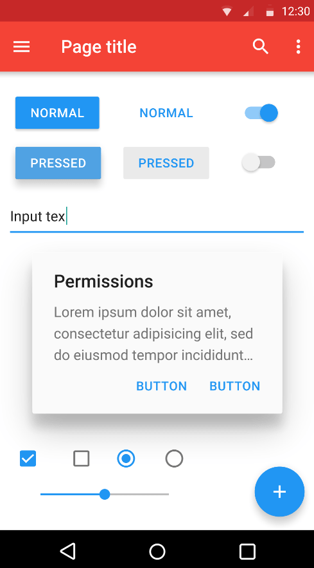
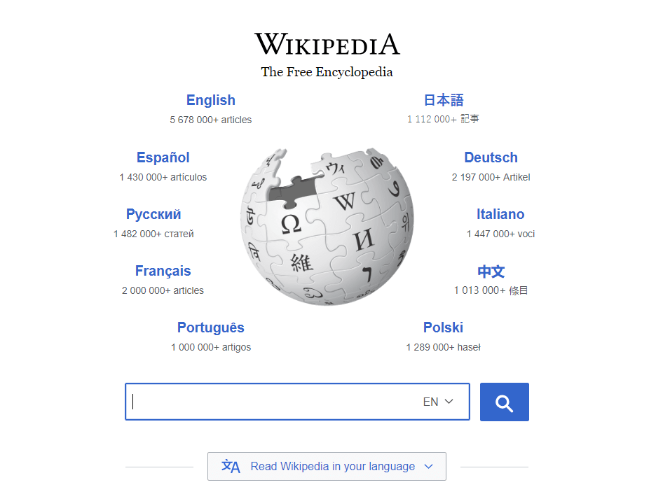
Modular and radial symmetry layout

Slide 12

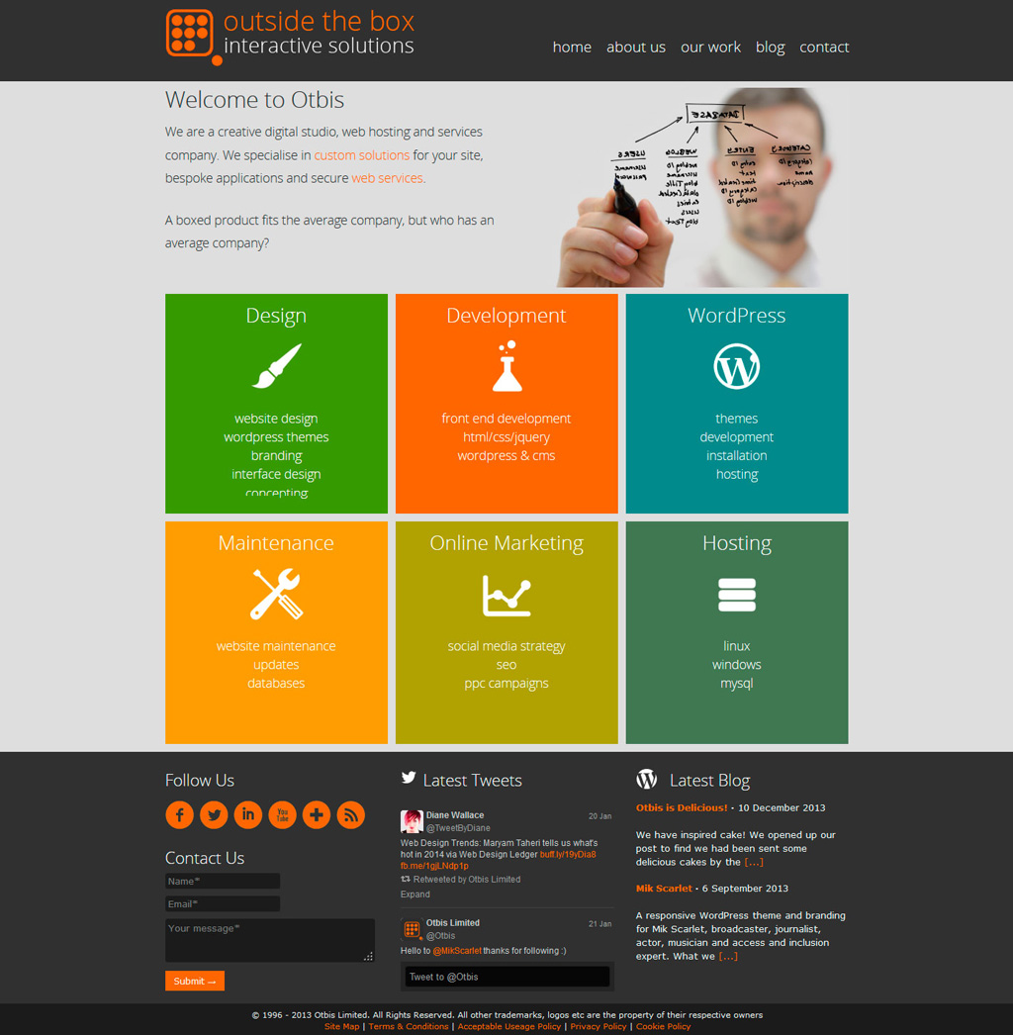
Fixed sidebar and box layout

Slide 13
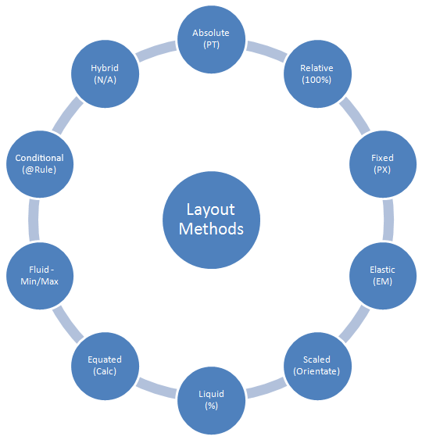
Another classification
Petrivska Marianna

Slide 14
What about SEO? 93% of all Internet experiences start with a search engine. So your SEO strategy must go far beyond just adding keywords to your blog posts. Create an XML sitemap. This will make it easier for search engine crawlers to analyze content on your website. A proper sitemap shows Google that you don’t have duplicate content, which can damage your SEO rankings.
Petrivska Marianna

Slide 15
1)Keep Your Code Simple 2)Use Frameworks(Foundation and Bootstrap) 3)Define Valid Doctype(the first line in HTML document) 4)Use linters( Dirty Markup and CSS Lint) or set it up in your workspace 5)Use browser developer tools 5)Validate(use W3C HTML Validator and CSS Validator) 6)Don’t Skip Cross-Browser Testing (CrossBrowserTesting gives you access to do this in over 1,500 browsers, so you never have to wonder what users are seeing when they visit your page from a different machine.)
How to make a site with cross-browser implementation

Slide 16
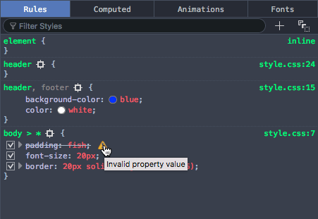
How to fix cross-browser problems? You can add fallback content in between the opening and closing tags, and non-supporting browsers will effectively ignore the outer element and run the nested content. <video id="video" controls preload="metadata" poster="img/poster.jpg"> <source src="video/tears-of-steel-battle-clip-medium.mp4" type="video/mp4"> <source src="video/tears-of-steel-battle-clip-medium.webm" type="video/webm"> <source src="video/tears-of-steel-battle-clip-medium.ogg" type="video/ogg"> <!-- Flash fallback --> <object type="application/x-shockwave-flash" data="flash-player.swf?videoUrl=video/tears-of-steel-battle-clip-medium.mp4" width="1024" height="576"> <param name="movie" value="flash-player.swf?videoUrl=video/tears-of-steel-battle-clip-medium.mp4" /> <param name="allowfullscreen" value="true" /> <param name="wmode" value="transparent" /> <param name="flashvars" value="controlbar=over&amp;image=img/poster.jpg&amp;file=flash-player.swf?videoUrl=video/tears-of-steel-battle-clip-medium.mp4" /> <img alt="Tears of Steel poster image" src="img/poster.jpg" width="1024" height="428" title="No video playback possible, please download the video from the link below" /> </object> <!-- Offer download --> <a href="video/tears-of-steel-battle-clip-medium.mp4">Download MP4</a> </video>
Petrivska Marianna

Slide 17


1)Repeat commands just in case CSS is arguably better at fallbacks than HTML. Example: button { background-color: #ff0000; background-color: rgba(255,0,0,1); } 2)Conditional comments <!--[if lte IE 8]> <script src="ie-fix.js"></script> <link href="ie-fix.css" rel="stylesheet" type="text/css"> <![endif]--> ***lte means "less than or equal to", but you can also use lt, gt, gte, ! for NOT, and other logical syntax 3)Check your selector using DOM inspector at dev tools
How to fix cross-browser problems?

Slide 18
Handling CSS prefixes Mozilla uses -moz- Chrome/Opera/Safari use -webkit- Microsoft uses -ms- It is worth putting the non-prefixed version last, because that will be the most up-to-date version, which you'll want browsers to use if possible. Get free of CSS prefix with the site http://leaverou.github.io/prefixfree/ and https://postcss.org/ which will automatically detect what capabilities are possessed by browsers viewing the page and add prefixes as appropriate
Petrivska Marianna

Slide 19
1)Much of the layout work on the web is done using floats — this is because floats are well-supported (way back to IE4, albeit with a number of bugs that would also need to be investigated if you were to try to support IE that far back). 2)CSS grids and flexbox are well-supported in modern browsers, but provide problems in older browsers. Conclusion: You could apply a flexbox layout to modern browsers, then instead apply a floated layout to older browsers that don't support flexbox. Media queries are not supported in IE 8 or less, so if you want to use a mobile first layout and have the desktop layout then apply to old IE versions, you'll have to apply a media query polyfill to your page, like css3-mediaqueries-js, or Respond.js.
Support for new layout features
Responsive design

Slide 20
38% of users will stop engaging with a website that has an unattractive layout. After a bad experience, 88% of consumers are unlikely to return to a website!!!
Petrivska Marianna

Slide 21
Sources https://colibriwp.com/blog/website-layout-design-ideas/ https://drudesk.com/blog/types-of-site-layout https://www.crazyegg.com/blog/best-website-layouts/ https://www.quicksprout.com/website-design-best-practices/ https://www.crazyegg.com/blog/website-design-best-practices/ https://www.webfx.com/blog/web-design/a-guide-on-layout-types-in-web-design/ https://developer.mozilla.org/en-US/docs/Learn/Tools_and_testing/Cross_browser_testing/HTML_and_CSS
Petrivska Marianna

Slide 22
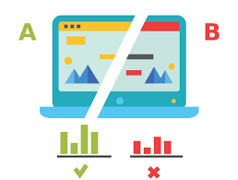
Thank you and time for summary
Layout is one of the most important things to consider before making a site.
The more minimalistic, the more convenient for users.
Use colors and contrasts to emphasize on the CTA as well as breadcrumbs and bullets.
Think of improving SEO rankings.
Conditional comments and polyfill will help to avoid cross-browser problems.
Automatically or manually you still should add prefixes in CSS.
Differentiate floats from flexboxes and CSS grids to avoid errors in older versions of browsers
Do not forget about scrolling and heat maps, A/B and cross-browser test.
P.S.https://caniuse.com/ is always there to help you)

